Slide 1
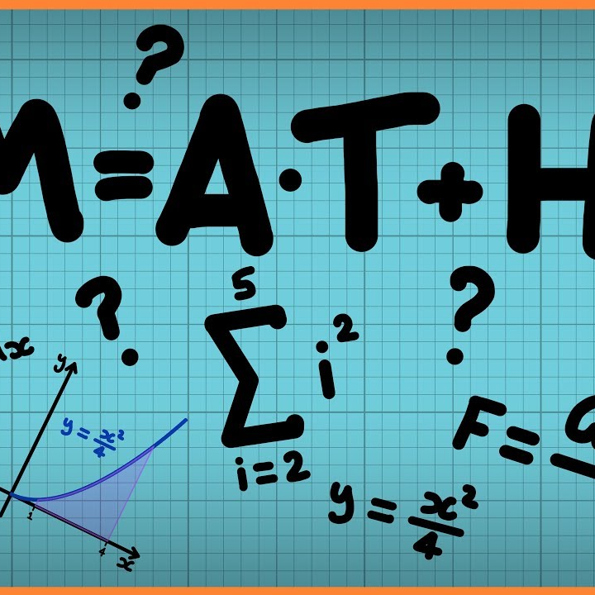

Adaptive Color Quantization for Efficient Image Compression Using Convolutional Autoencoders
By
Blessing Nwala
Department of Computer Science
Bowling Green State University
Bowling Green, Ohio, USA
unwala@bgsu.edu

Slide 2
Abstract
Problem: Fixed quantization methods fail to preserve image quality in complex regions and underutilize simpler regions.
Proposed Solution: Adaptive color quantization using convolutional autoencoders (CAEs).
Aim: Develop a model that adjusts color depth dynamically based on regional image complexity.
Dataset: CIFAR-100.
Metrics: Evaluate using Peak Signal-to-Noise Ratio (PSNR) and Structural Similarity Index (SSIM).

Slide 3
Introduction
Importance of Image Compression:
Reduces storage and bandwidth needs.
Essential in modern digital processing applications.
Limitations of Traditional Methods:
Fixed strategies (e.g., K-means, Median Cut) fail to adapt to image complexity.
Significant quality loss in complex areas.
Redundant data retention in simpler regions.

Slide 4
Introduction Continued…
Advantages of CAEs:
They automatically learn spatial hierarchies in images without manual feature selection.
Their convolutional layers capture local patterns that are essential for efficient representation.
CAEs are trained end-to-end, enabling them to optimize compression and reconstruction tasks simultaneously.
Objectives:
Design an adaptive color quantization model using CAEs.
Validate using PSNR and SSIM metrics on CIFAR-100.
Compare performance with traditional quantization methods.

Slide 5
Related work
Lei et al
Adaptive compression via semantic prioritization.
Limitation: Dependency on external pre-trained models reduces generalizability.
2. Dumas et al.
Quantization-independent training for CAEs.
Limitation: Requires multiple configurations, limiting scalability.
3. Jannani et al.
Explored CAEs for general image compression.
Limitation: Uniform compression ignores regional complexities.

Slide 6
Related work continued…
4. Xu et al:
Low-bit quantization for computational efficiency.
Limitation: Poor adaptability for varying image complexities.
5. Chou & Liu:
Statistical techniques for adaptive color quantization.
Limitation: Lack of automation and modern deep learning integration.
Major Research Gap:
Existing techniques lack scalability, adaptability, and efficiency.

Slide 7
Methodology
Introduction
System architecture integrates:
Data preprocessing.
Feature extraction.
Image reconstruction modules.
Key Goals:
Efficiency.
Scalability.
Automation across varied datasets

Slide 8
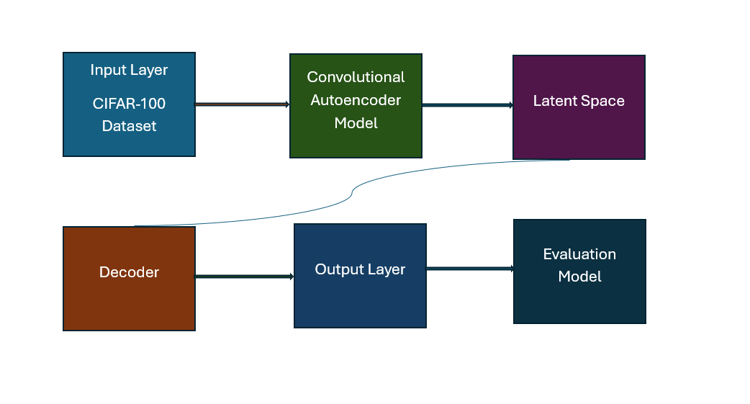
System Architecture Description
Input Layer:
Preprocesses raw images (normalization and resizing).
Encoder:
Uses convolutional layers to extract low-dimensional feature representations.
Latent Space:
Bottleneck layer stores compressed image data, removing redundancy.
Decoder:
Reconstructs images from latent space with adaptive quantization for regional complexities.
Output Layer:
Produces reconstructed images with reduced data size while maintaining visual quality.
Evaluation Module:
Calculates metrics like PSNR and SSIM to assess image compression quality and fidelity.

Slide 9
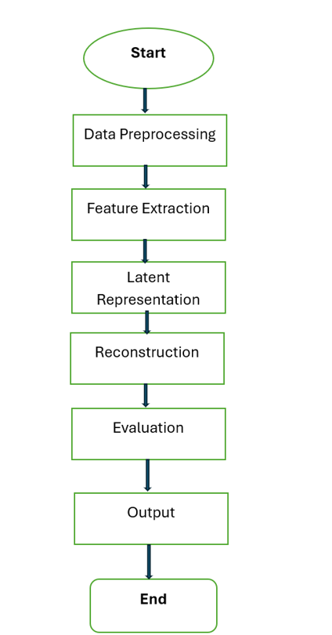
Flow Chart
Flow Chart Description
Start: User uploads image data.
Preprocessing: Images are resized and normalized.
Feature Extraction: Encoder processes input to extract low-dimensional features.
Latent Representation: Features stored in the bottleneck layer.
Reconstruction: Decoder reconstructs images with adaptive quantization.
Evaluation: PSNR and SSIM calculated to assess compression quality.
Output: Reconstructed images and results displayed for user review.
End: Process concludes with compressed images for retrieval.

Slide 10
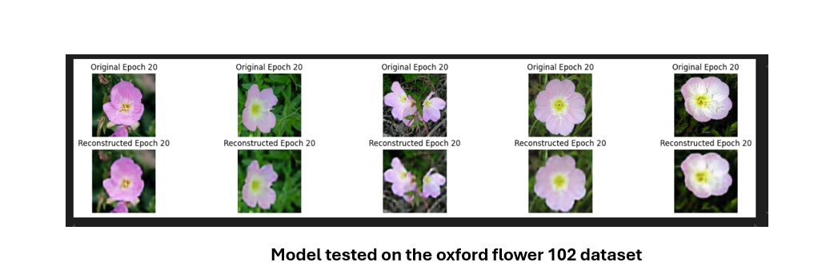
System Analysis
Focuses on evaluating functionality, performance, and usability.
Ensures alignment with objectives like adaptive color quantization and overcoming traditional compression challenges.
System Analysis Description
Strengths:
Adapts to diverse datasets efficiently.
Automates preprocessing, compression, and evaluation workflows.
Challenges:
High-resolution images increase computational demand.
Requires fine-tuning hyperparameters (e.g., learning rate).
Future Enhancements:
Advanced loss functions for enhanced compression fidelity.
Expand system to accommodate video compression tasks.

Slide 11
Discussion of Results and Justification of Metrics
Metrics Used:
PSNR: Measures pixel-level similarity between original and reconstructed images.
SSIM: Evaluates structural similarity and perceptual quality.
Structure of the Convolutional Layers and Kernels
Encoder: Progressively increases kernel count (64 → 128 → 256).
Latent Space: Bottleneck layer captures essential features.
Decoder: Mirrors encoder to reconstruct images (256 → 128 → 64).
Total Kernels: 896 across encoder and decoder.
Justification and Significance of Metrics
PSNR (26.08): Reflects similarity to the original image.
SSIM (0.8558): Ensures perceptual quality aligns with human vision.
Reconstruction Accuracy: Provides an interpretable measure of overall performance.

Slide 12
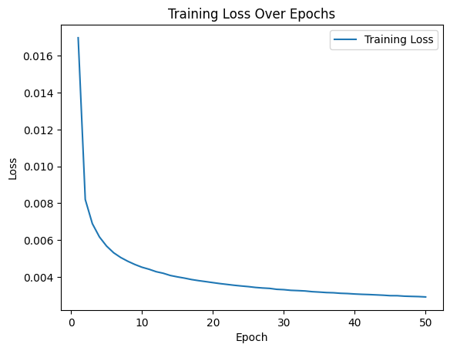
Interpretation of Results
Training Loss Over 50 Epochs
Loss reduced from 0.0170 to 0.0029, demonstrating effective optimization.

Slide 13
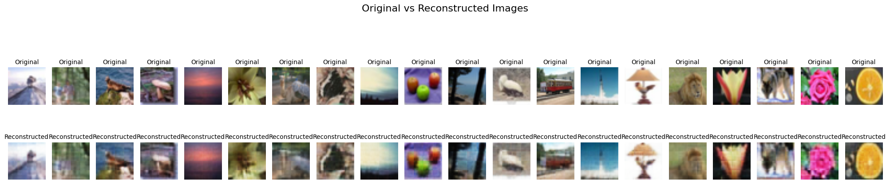
Interpretation of Results
Original and Reconstructed Images: High retention of visual fidelity; slight blurring in complex areas.

Slide 14
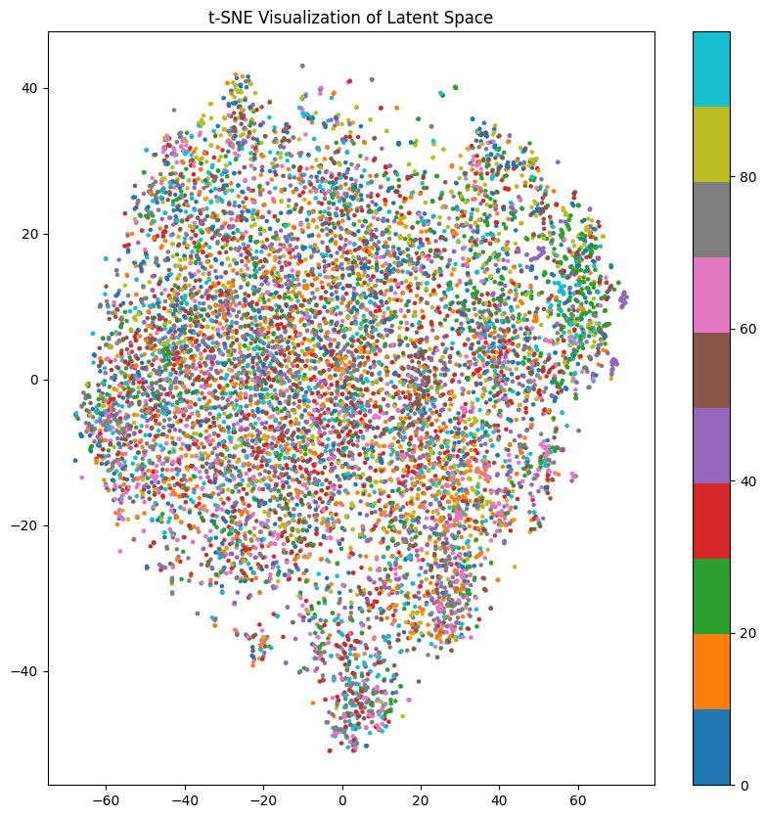
Interpretation of Results
t-SNE Visualization: Clusters latent space representations effectively.

Slide 15
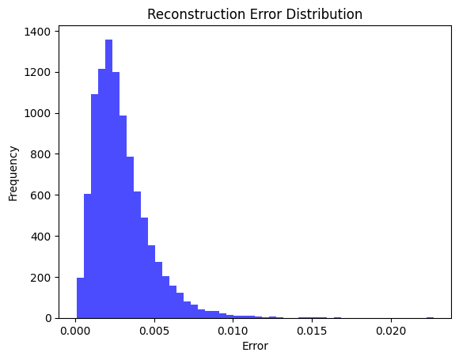
Interpretation of Results
Reconstruction Error Distribution:
Majority exhibit low error; minor errors in complex cases.

Slide 16
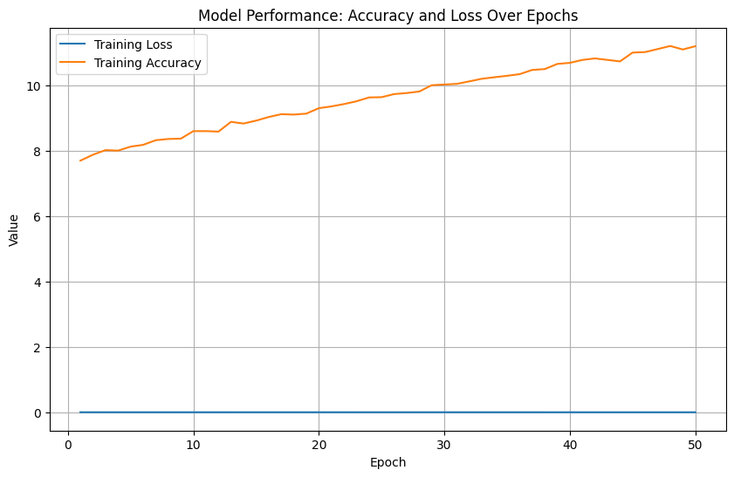
Interpretation of Results
Model Performance:
Concurrent trends in training accuracy and loss confirm effective learning.

Slide 17
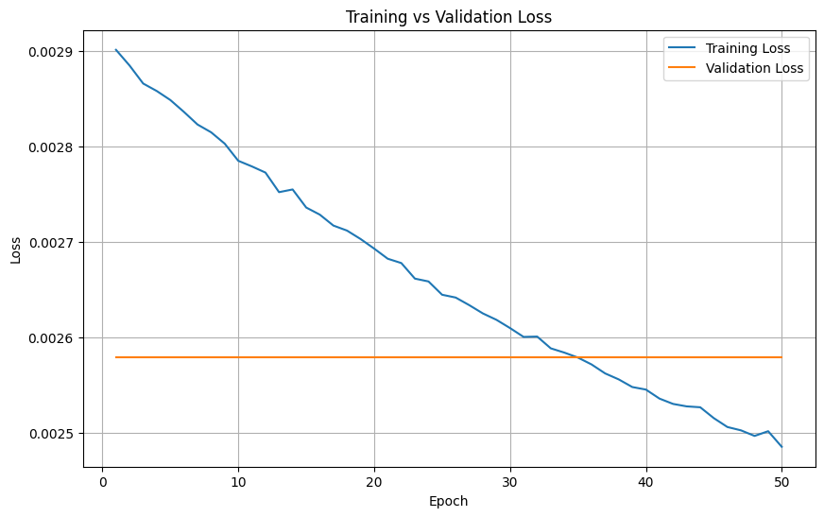
Interpretation of Results
Training vs Validation Loss
Validation stabilizes; indicates limited improvement on unseen data.

Slide 18
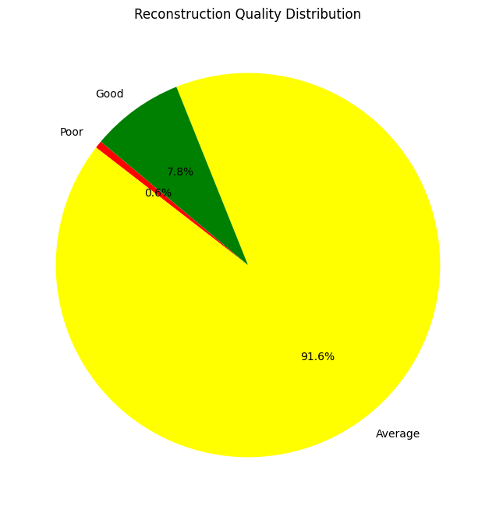
Interpretation of Results
Reconstruction Quality Distribution
Majority images classified as Good or Average based on PSNR.

Slide 19
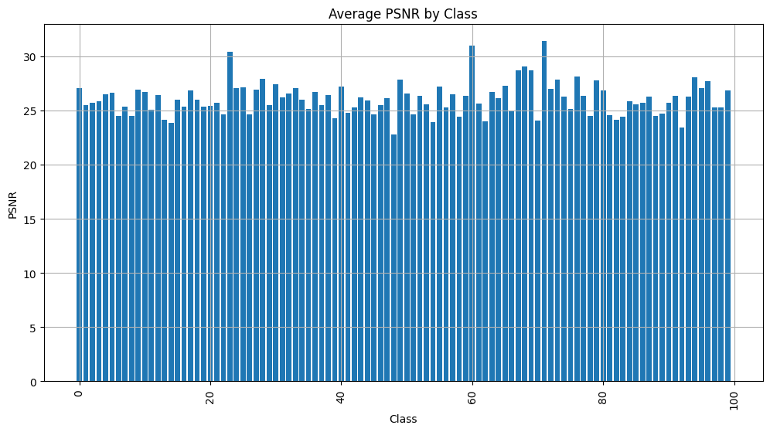
Interpretation of Results
Average PSNR by Class
Consistent performance across different CIFAR-100 classes.

Slide 20
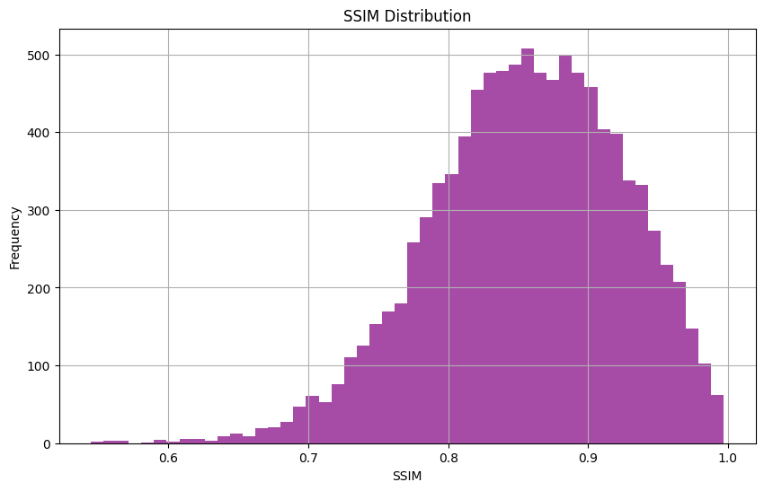
Interpretation of Results
SSIM Distribution
Peaks between 0.8–0.9 for structural similarity.

Slide 21
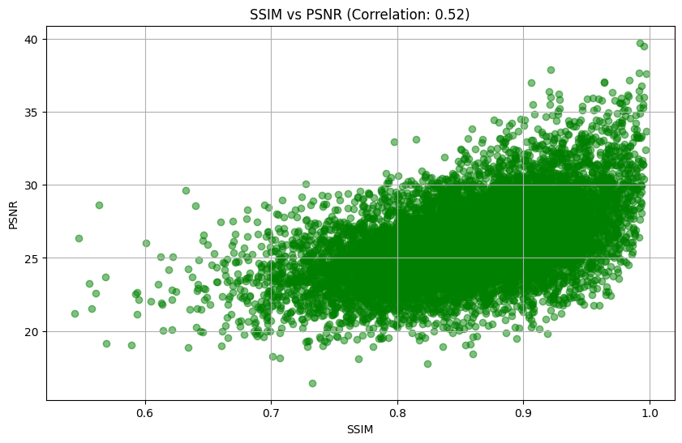
Interpretation of Results
SSIM vs PSNR Correlation:
Positive correlation (r = 0.52).

Slide 22
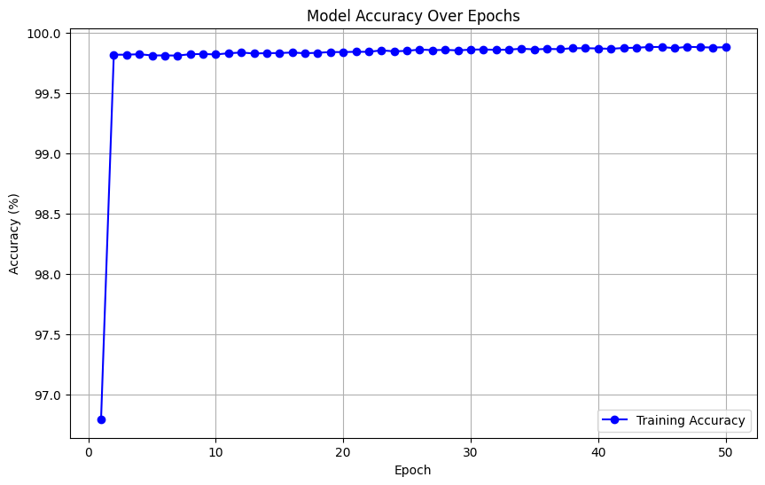
Interpretation of Results
Model Accuracy Over Epochs
Graph Details:
Tracks accuracy and loss trends over training epochs.
Demonstrates rapid convergence within the initial epochs.
Stabilizes around 99.88% accuracy by the 50th epoch.
Insights:
Correlation between declining loss and increasing accuracy.
Confirms effective learning and robust generalization capability.

Slide 23
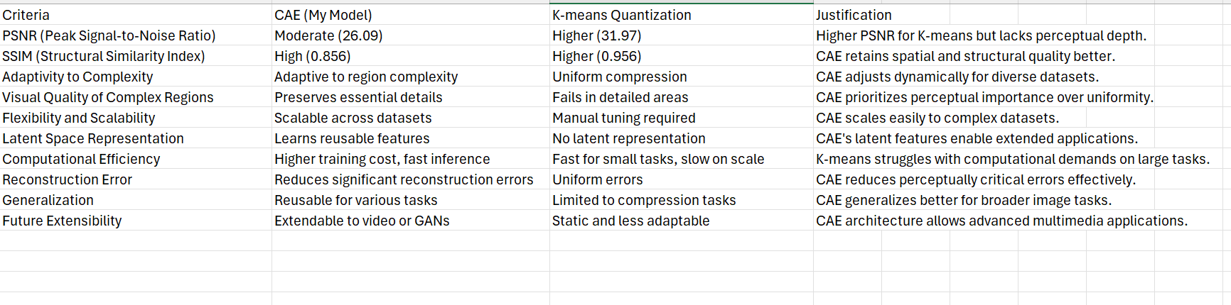
Interpretation of Results
Comparison Table: CAE Model vs. Traditional Model
Convolutional Autoencoder (CAE):
SSIM: 0.8558 (strong structural similarity).
PSNR: 26.08 (moderate pixel-level accuracy).
Adaptability: Dynamically adjusts to complex image features.
Scalability: Handles diverse datasets efficiently.
Traditional K-means:
High PSNR but lacks adaptability.
Struggles with regional complexity and scalability.

Slide 24
Conclusion
Adaptive compression using CAEs effectively balances quality and efficiency.
Demonstrates significant improvements in fidelity (PSNR: 26.08, SSIM: 0.8558) on CIFAR-100.
Surpasses traditional static methods in flexibility and scalability.

Slide 25
Future Work
Test on high-resolution datasets.
Integrate hybrid architectures (e.g., GANs, transformers).
Optimize for real-time applications.
Expand to video compression, leveraging motion estimation techniques.

